Slide 1

Face Mask Detection Using Convolutional Neural Networks

Slide 2

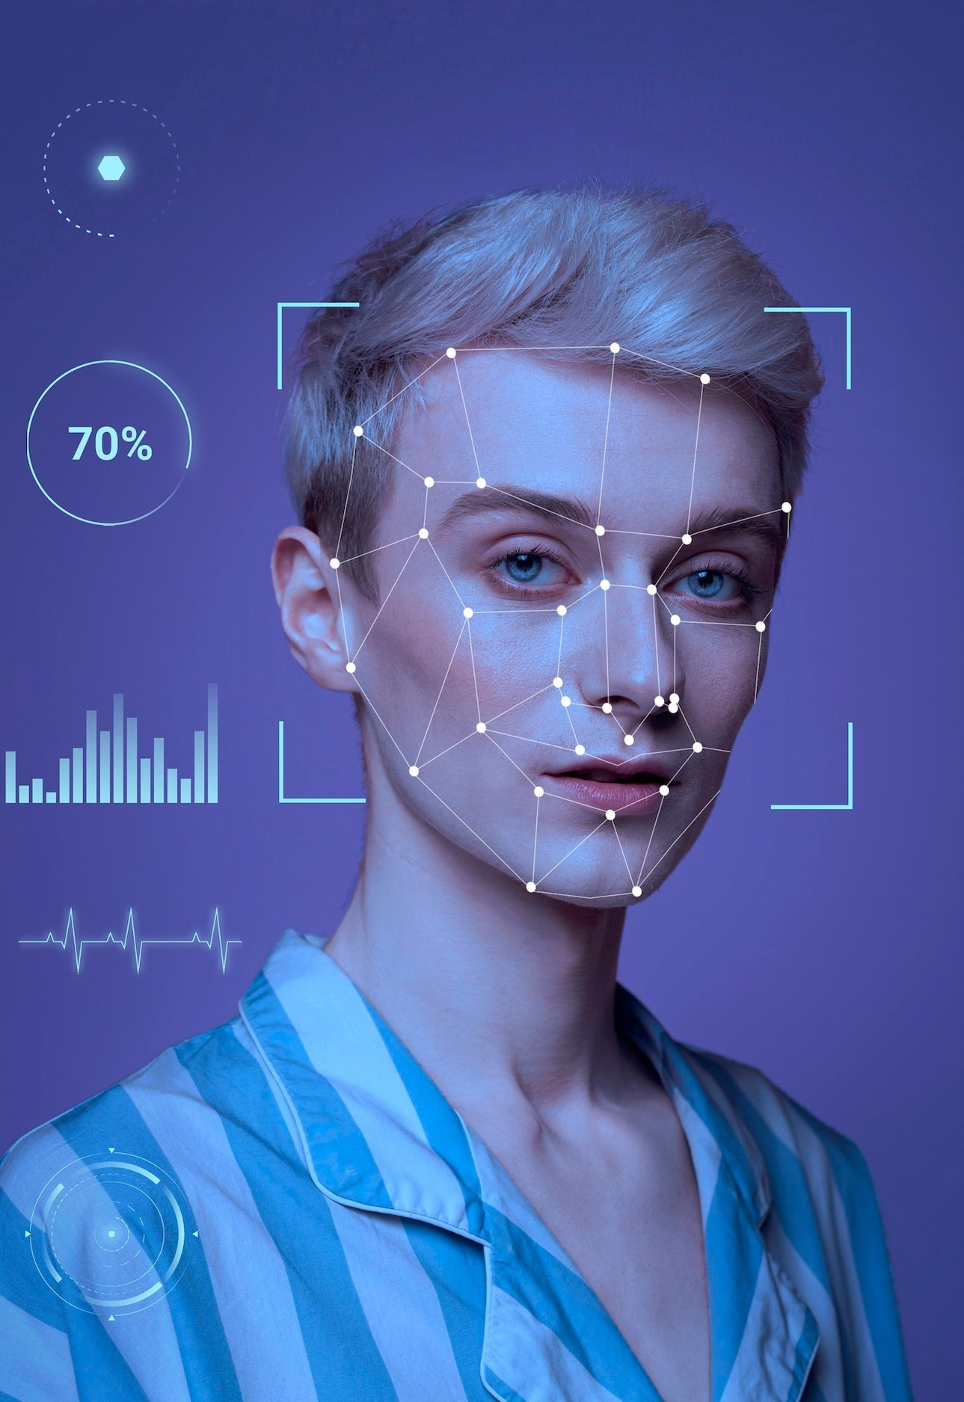
Introduction
The COVID-19 pandemic has highlighted the importance of wearing face masks in public spaces. Manual monitoring and detection of face masks can be time-consuming and inefficient. This project proposes the development of a face mask detection system using Convolutional Neural Networks (CNNs) in deep learning.

Slide 3

Objectives
Design and train a CNN model to detect face masks in images and videos.
Achieve high accuracy in detecting face masks in various environments and lighting conditions.
Develop a real-time face mask detection system for practical applications.

Slide 4
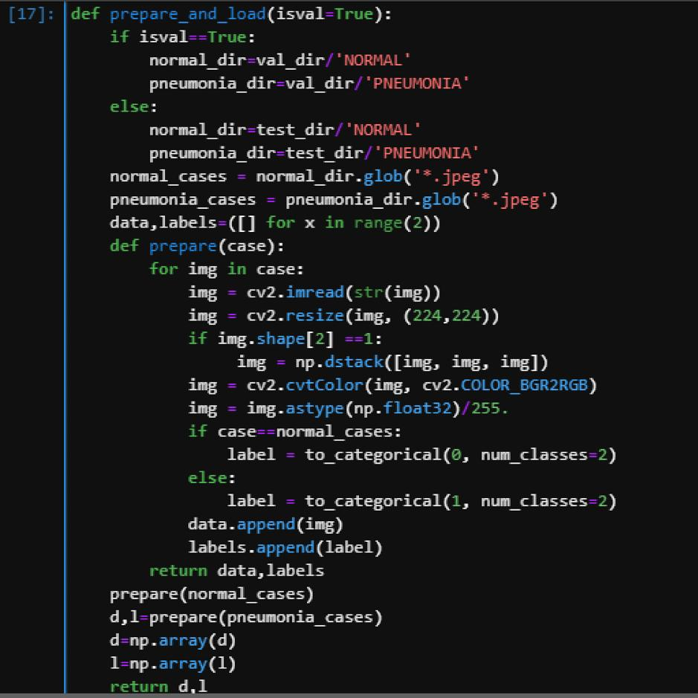
Methodology and Training Data
Data Collection: Gather a large dataset of images and videos with faces with and without masks.
Data Preprocessing: Label and preprocess the data for training.
CNN Model Design: Design a CNN architecture to detect face masks.
Model Training: Train the model using the preprocessed data with the help of libraries like Keras.
Model Evaluation: Evaluate the model's performance on a test dataset.

Slide 5
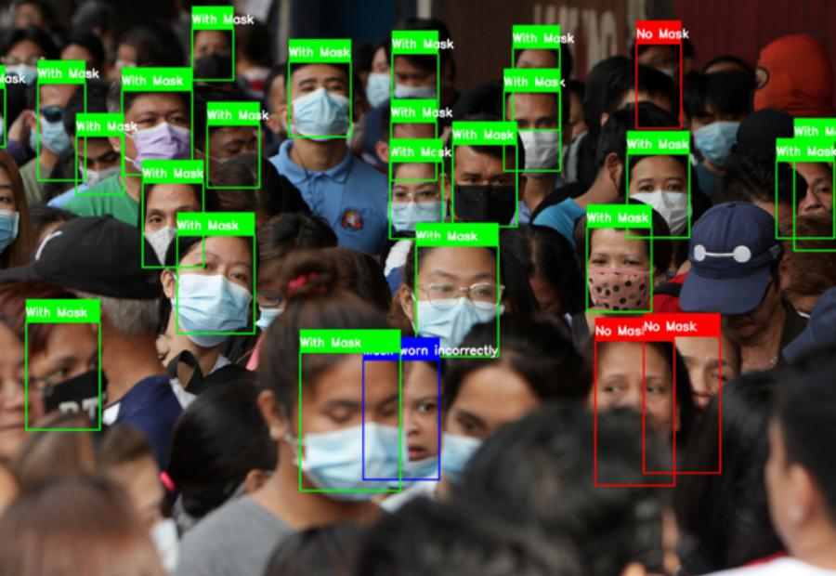
Model structure and build
A simple diagram showing the CNN model architecture
4 layers of CNN, Input layer: 128x128x3, Output layer: 2 classes (mask/no mask)
Trained on 8000 images with 80% training and 20% validation split
Table: | Epochs | Accuracy | Loss | Val Accuracy | | --- | --- | --- | --- | | 1 | 0.78. | 0.47 | 0.89 | | 2 | 0.89. | 0.27 | 0.90 | | 3 | 0.91 | 0.23. | 0.92 | | 4 | 0.93 | 0.1 2 | 0.92 | | 5 | 0.94 | 0.16. | 0.93 |

Slide 6

Fine Tune the Model
Test size: 0.3, Epochs: 15, Test accuracy: 97%
Table:| Epochs | Metric | Accuracy | Loss | Val Accuracy || --- | --- | --- | --- | ---
|| 1 | 0.93 | 0.21 | 0.92 |
| 2 | 0.95 | 0.18 | 0.93 ||
3 | 0.96 | 0.15 | 0.94 ||
4 | 0.97 | 0.13 | 0.95 ||
5 | 0.98 | 0.11 | 0.96 |

Slide 7

Conclusion
A CNN model with high accuracy in detecting face masks was developed and trained. The model achieved a test accuracy of 97% after fine-tuning. The system can be used for real-time face mask detection in practical applications.

